Slide 1
MongoDB
Amazon Xia

Slide 2
Agenda
Overview
High Availability through Replica Sets
Scalability through Sharding
Deployment Architectures

Slide 3
Overview
HUMONGOUS

Slide 4
Why MongoDB?
Document Data Model
App and DB data structures in harmony
Fast to develop against – quicker to market
Dynamic Schema
Polymorphic data is the norm
Data model can evolve as app evolves – quicker to iterate
Built-in Horizontal Scalability
Low infrastructure costs – commodity hosts & no need for SAN
Elasticity - start small and invest incrementally
Initial DB decision doesn’t constrain a successfully growing business, later on

Slide 5
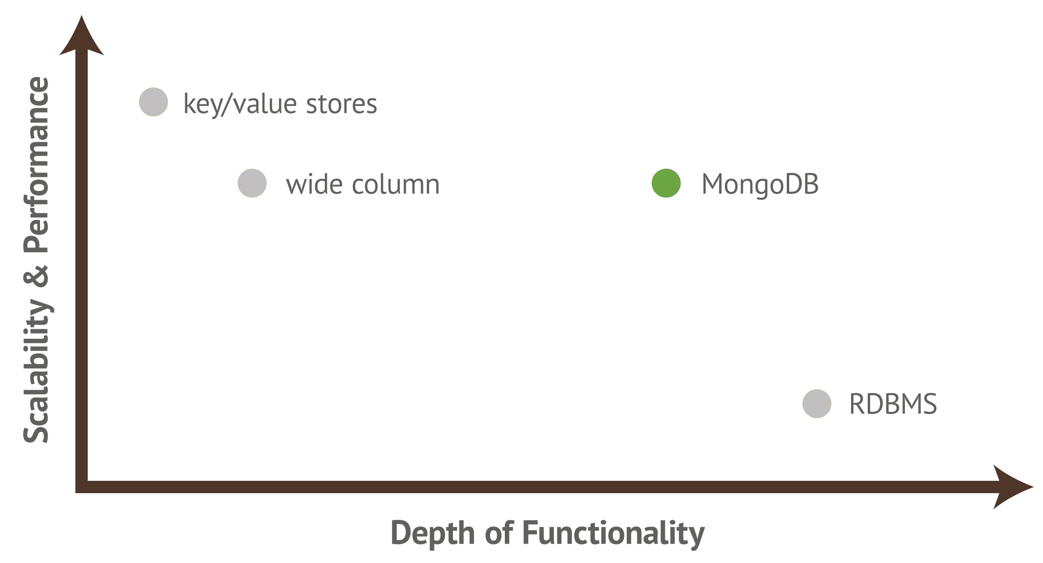
Operational Database

Slide 6
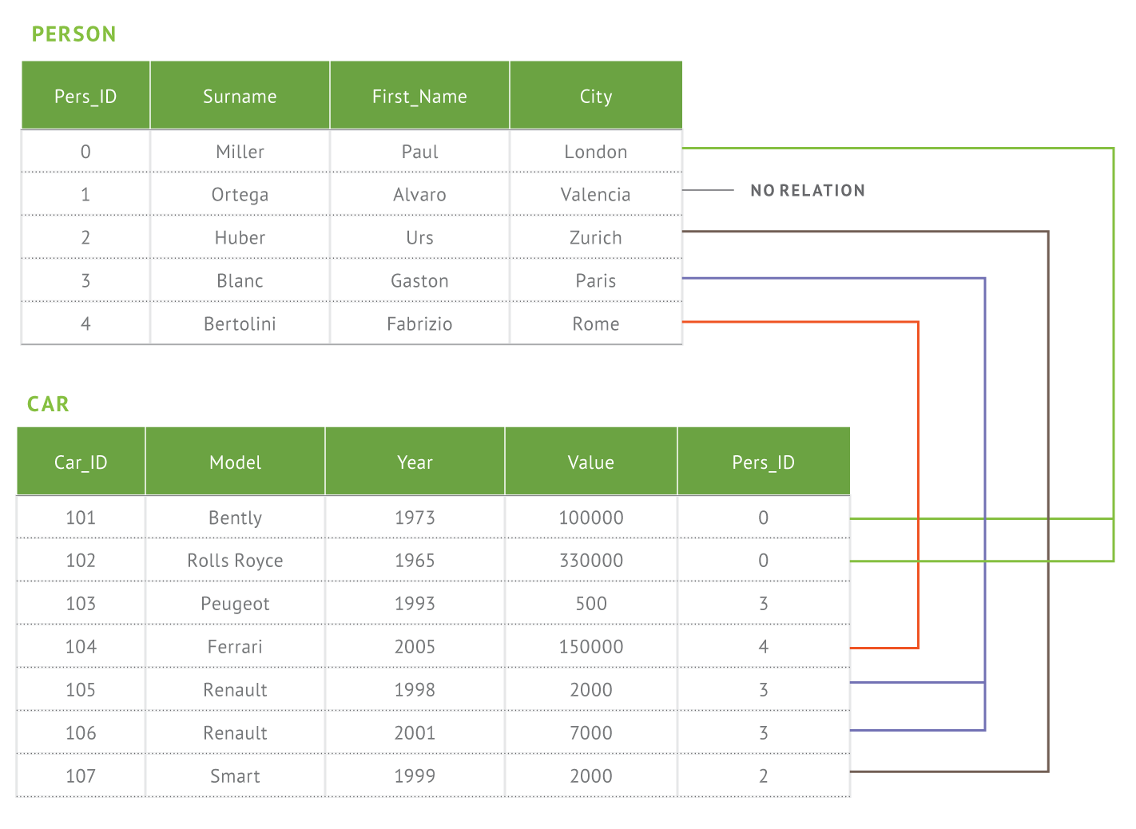
Document Data Model
Relational - Tables
Document - Collections
{ firstname: ‘Paul’,
surname: ‘Miller’,
city: ‘London’,
location: {
type: “Point”, coordinates :
[-0.128, 51.507]
},
cars: [
{ model: ‘Bentley’,
year: 1973,
value: 100000, … },
{ model: ‘Rolls Royce’,
year: 1965,
value: 330000, … }
]
}

Slide 7
Queries
Find Paul’s cars
{ firstname: ‘Paul’,
surname: ‘Miller’,
city: ‘London’,
location: {
type: “Point”, coordinates :
[-0.128, 51.507]
},
cars: [
{ model: ‘Bentley’,
year: 1973,
value: 100000, … },
{ model: ‘Rolls Royce’,
year: 1965,
value: 330000, … }
]
}
Geospatial
Find all of the car owners within 5km of Trafalgar Square
Text Search
Find all the cars with ‘leather seats’ in their description
Aggregation
& Map Reduce
Calculate the average value of every owner’s car collection, and show only the top 10

Slide 8
Document Model
• MongoDB is made up of collections
• Collections are composed of documents
• Each document is a set of key-value pairs
• No predefined schema
• Keys are always strings
• Values can be any (supported) data type
• Values can also be an array
• Values can also be a document

Slide 9
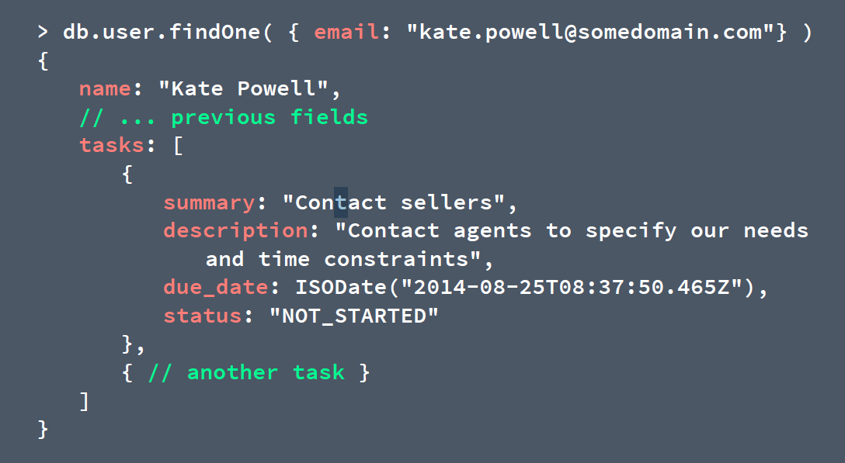
Embedding tasks

Slide 10
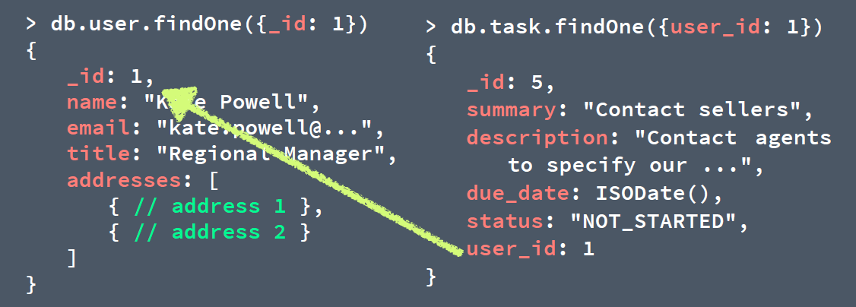
Referencing tasks
Tasks are unbounded items and our schema supports
that
• Application level joins
• Remember to create proper indexes (e.g. user_id)

Slide 11
One-to-many relations
• Embed when you have a few number of items on ‘many'
side
• Embed when you have some level of control on the
number of items on ‘many' side
• Reference when you cannot control the number of items
on the 'many' side
• Reference when you need to access to ‘many' side items
without parent entity scope

Slide 12
Denormalization
> db.product.find( { _id: 1 } )
{
_id: 1,
name: "Nike Pump Air Force 180",
tags: ["sports", "running"]
}
> db.comment.find( { product_id: 1 } )
{ score: 5, user: "user1", text: "Awesome shoes" }
{ score: 2, user: "user2", text: "Not for me.." }

Slide 13
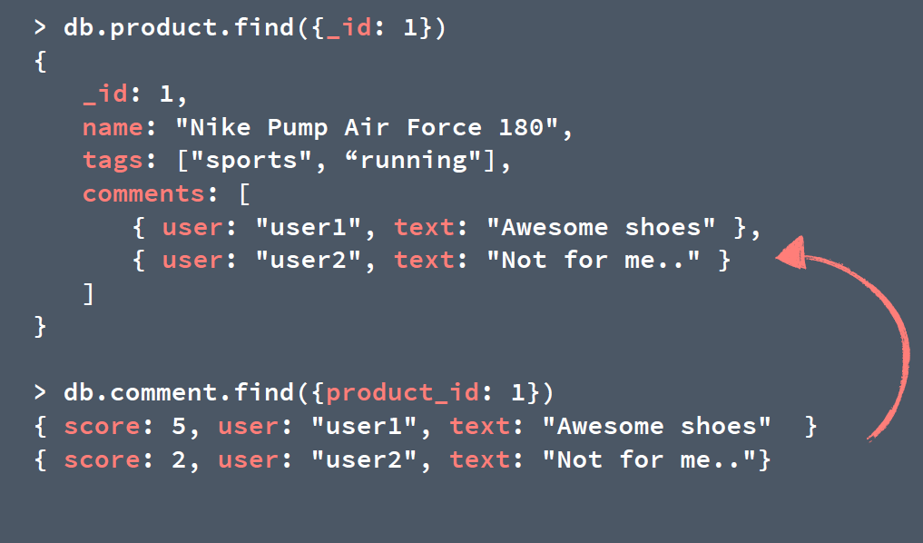
Denormalization

Slide 14
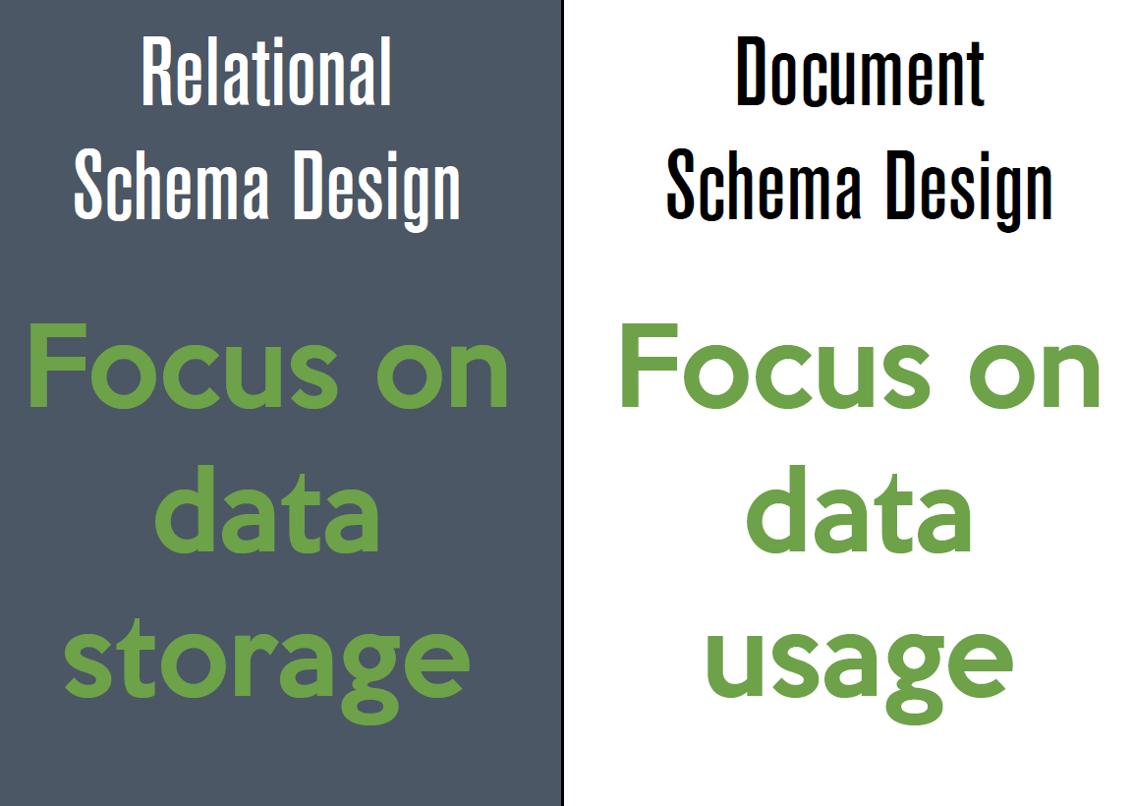

Slide 15
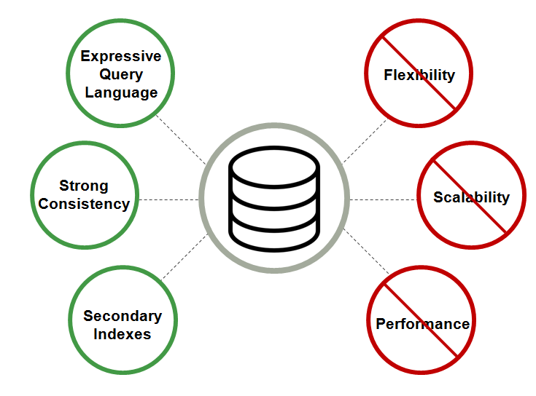
Relational

Slide 16
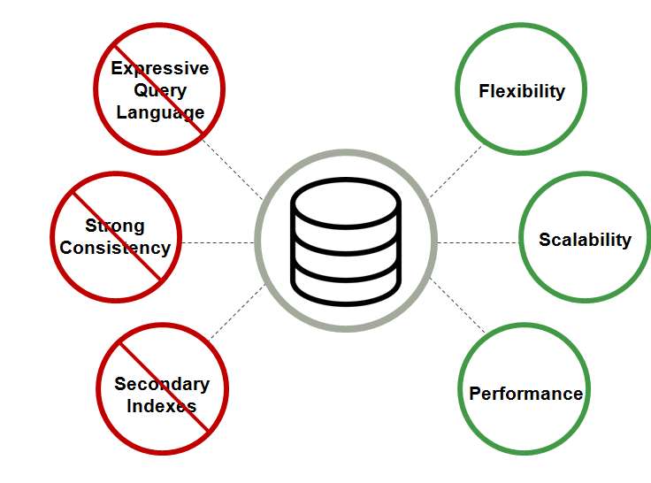
NoSQL

Slide 17
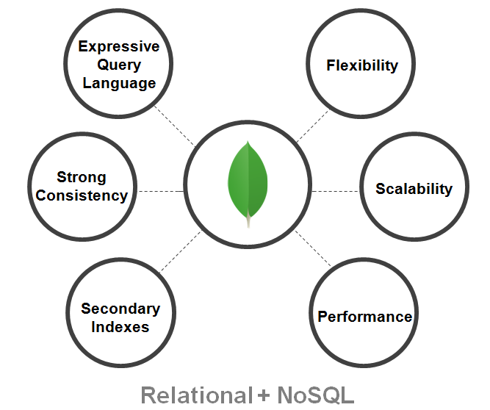

Slide 18
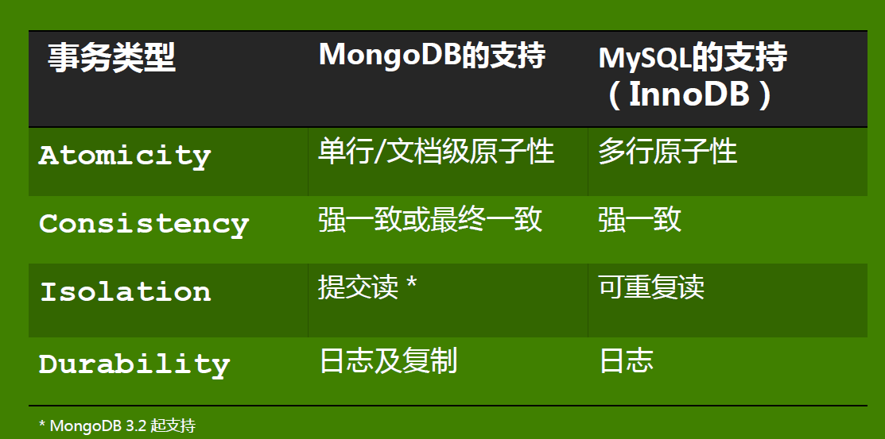
MongoDB ACID

Slide 19
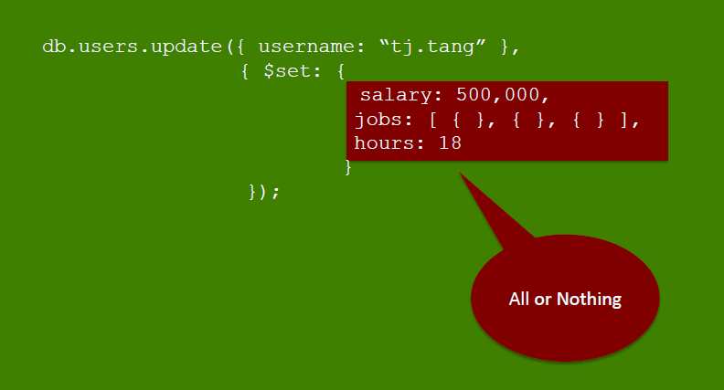

Slide 20
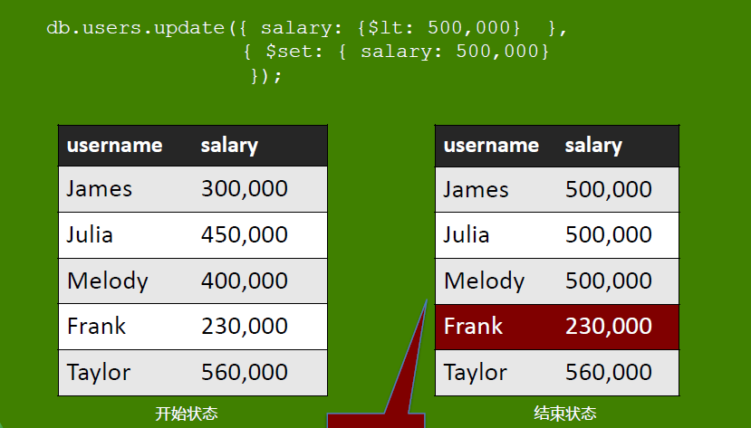

Slide 21
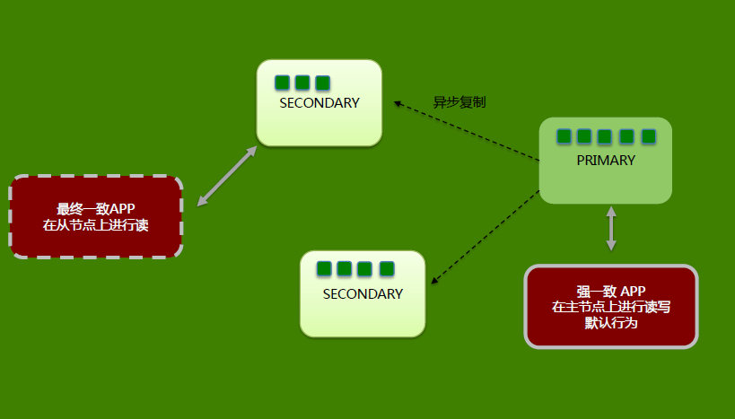

Slide 22
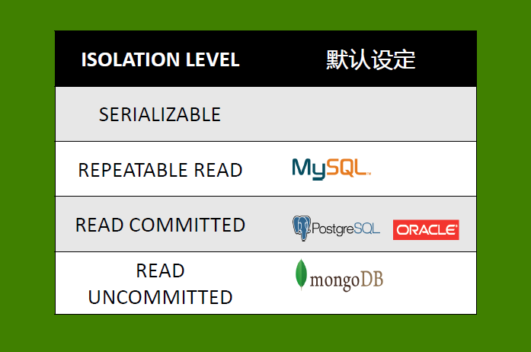

Slide 23
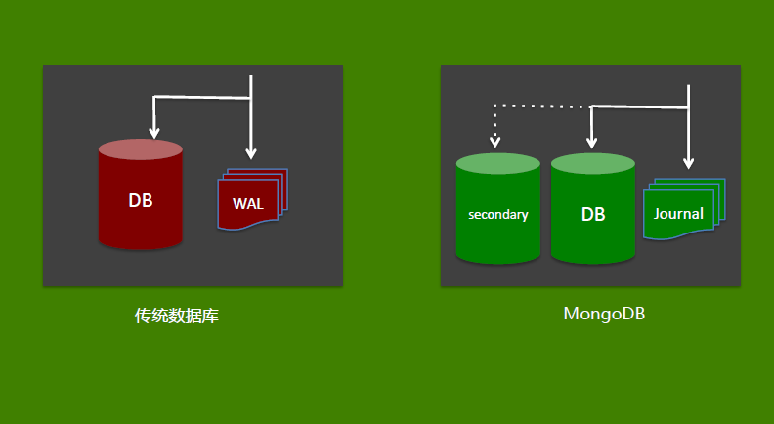

Slide 24
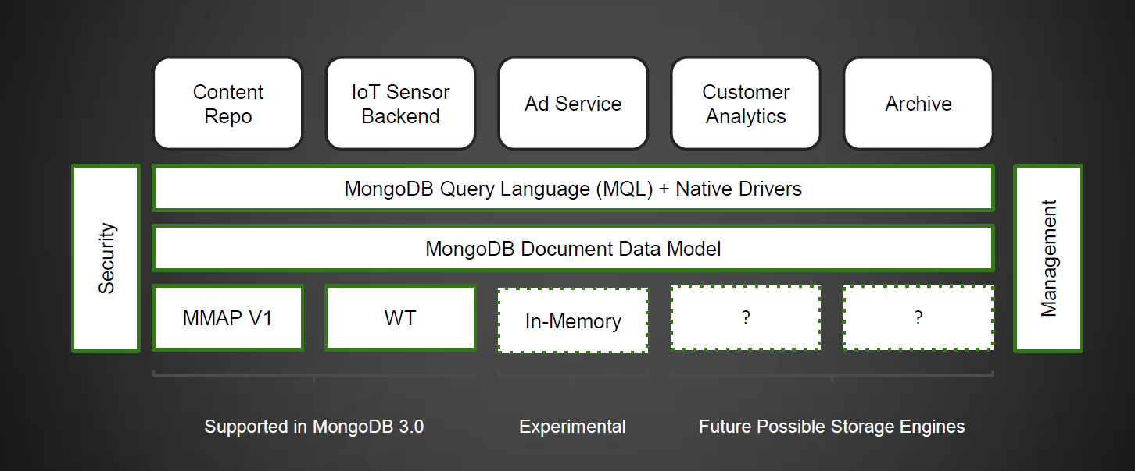
Storage Engine Layer

Slide 25
High Availability through Replica Sets

Slide 26
Replica Sets
Replica Set – two or more copies
Automated Replication & Failover
Addresses availability
High Availability
Disaster Recovery
Maintenance (rolling updates)
Deployment Flexibility
Data locality to users
Delayed replicas
Workload isolation

Slide 27
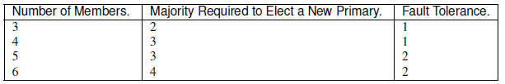
Replica design
Majority:
Consider Fault Tolerance for a replica set is the number of members that can become unavailable
and still leave enough members in the set to elect a primary
Keep a Majority of Members in One Location When a replica set has members in multiple data centers, network partitions can prevent communication between data centers. To replicate data, members must be able to communicate to other members.

Slide 28
Replica Set - Initialised

Slide 29
Replica Set – Failure & Re-election

Slide 30
Replica Set – Failed-over

Slide 31
Replica Set - Recovery

Slide 32
Replica Set - Recovered

Slide 33
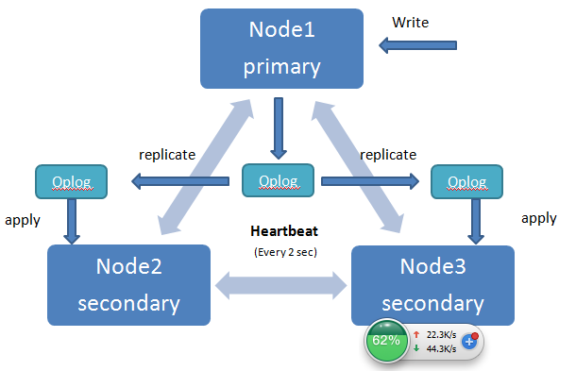

Slide 34
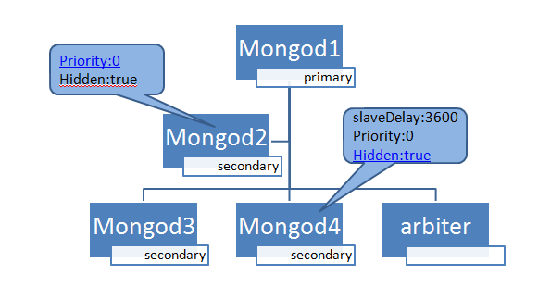

Slide 35
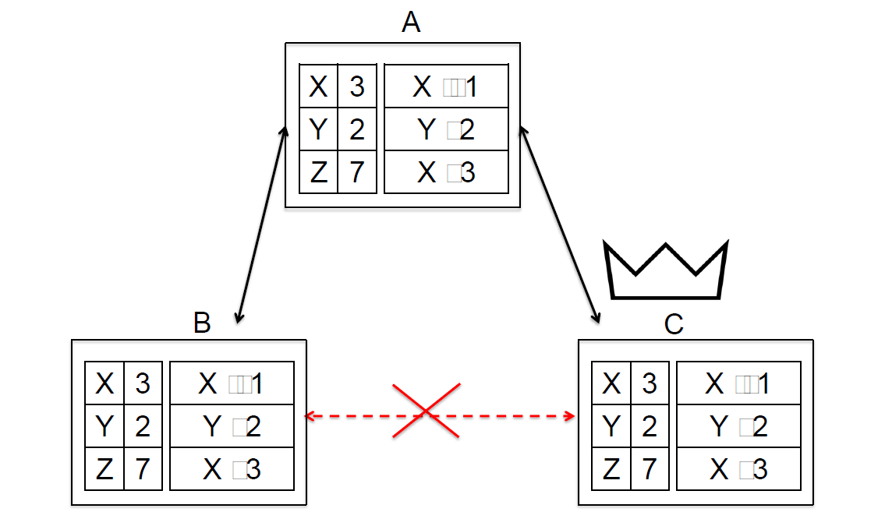

Slide 36

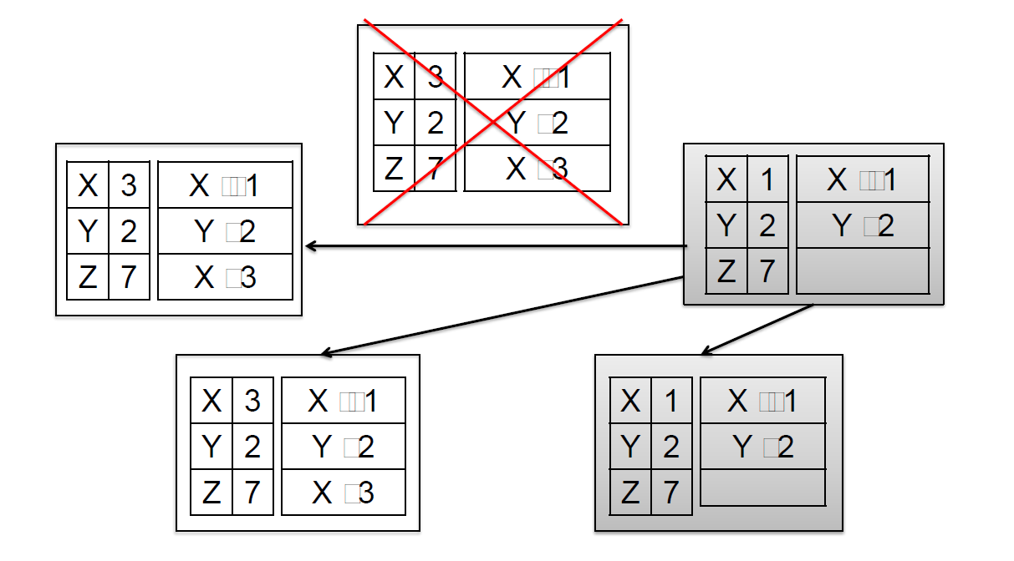

Slide 37
Write Concern
•w: 0|1|n|majority|tag
•j: 1
•wtimeout: millis

Slide 38
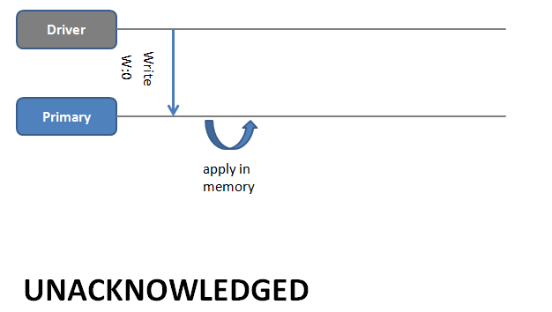

Slide 39
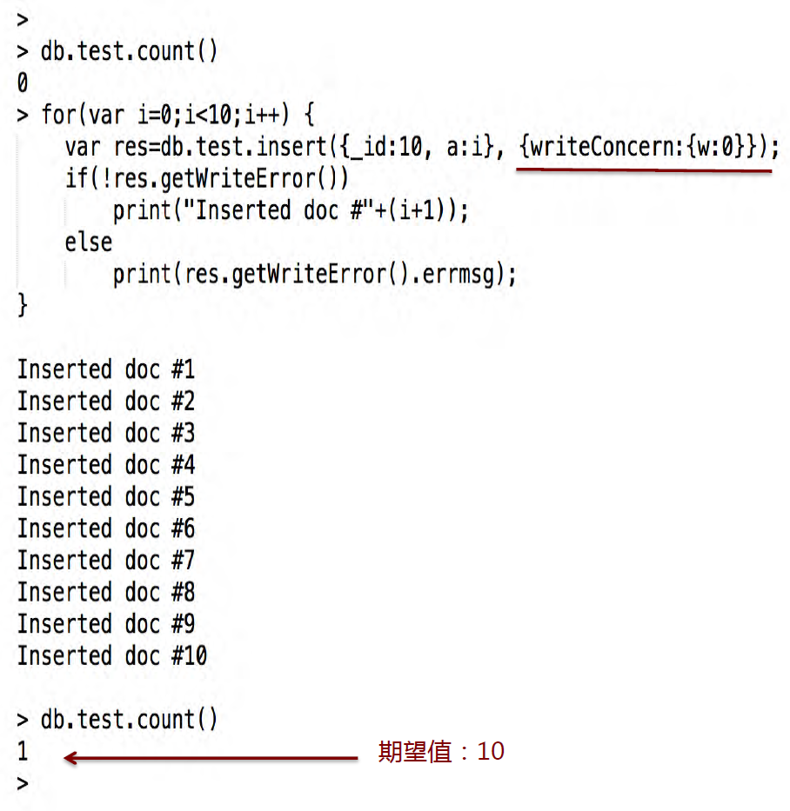

Slide 40
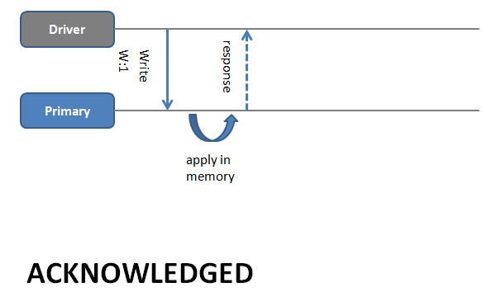

Slide 41
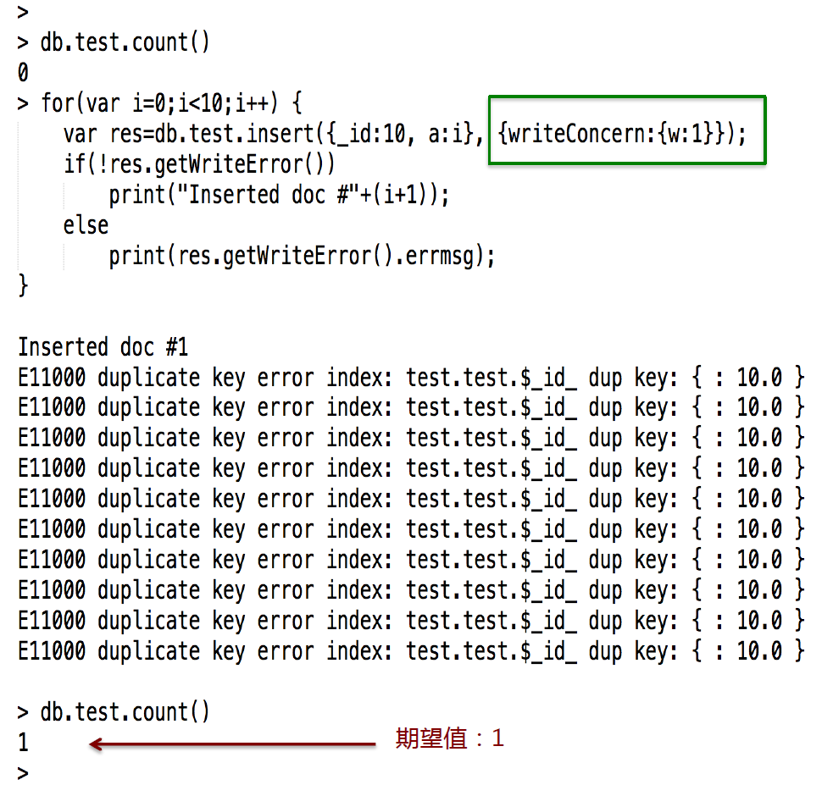

Slide 42
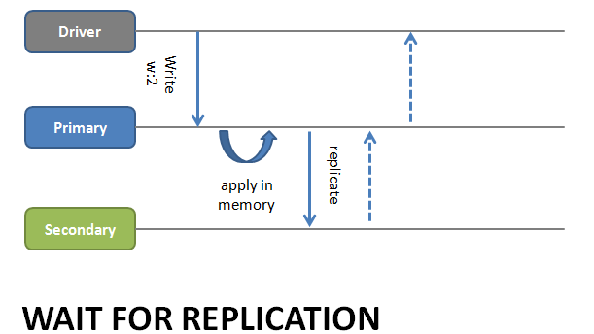
db.products.insert( { item: "envelopes", qty : 100, type: "Clasp" }, { writeConcern: { w: 2, wtimeout: 5000 } } )

Slide 43
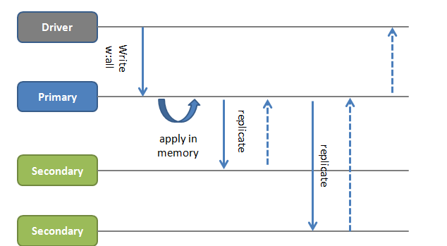

Slide 44
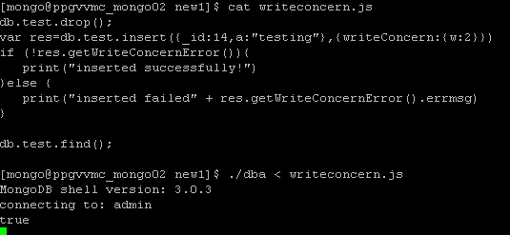
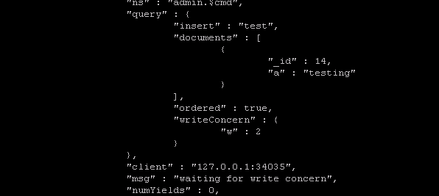
HANG

Slide 45
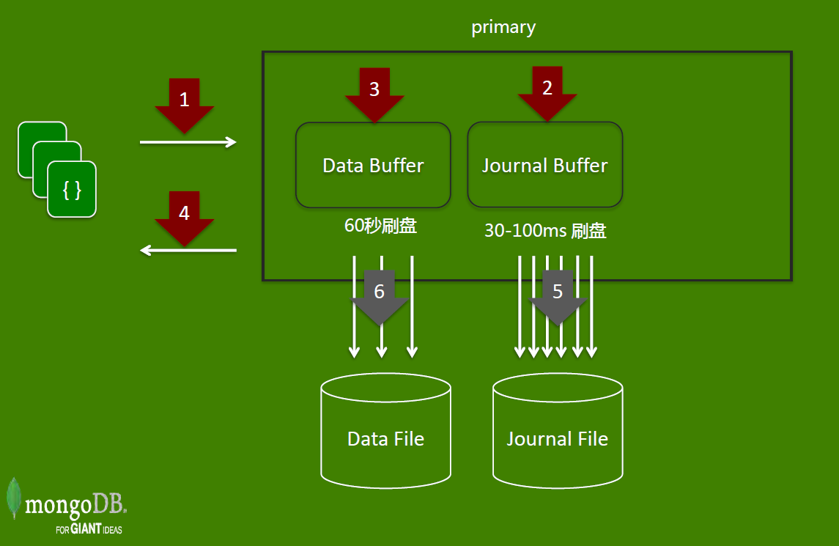

Slide 46
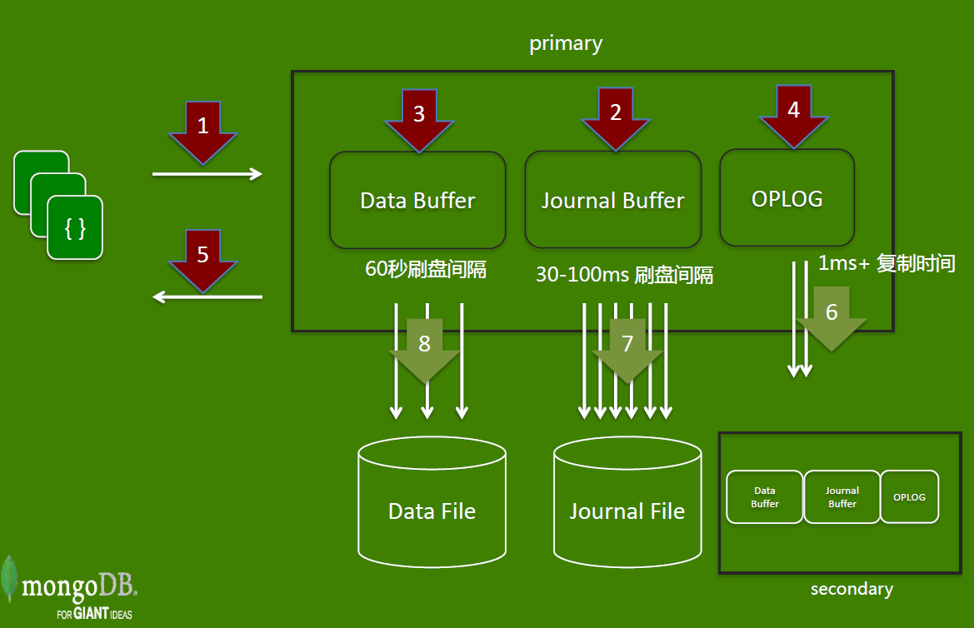

Slide 47
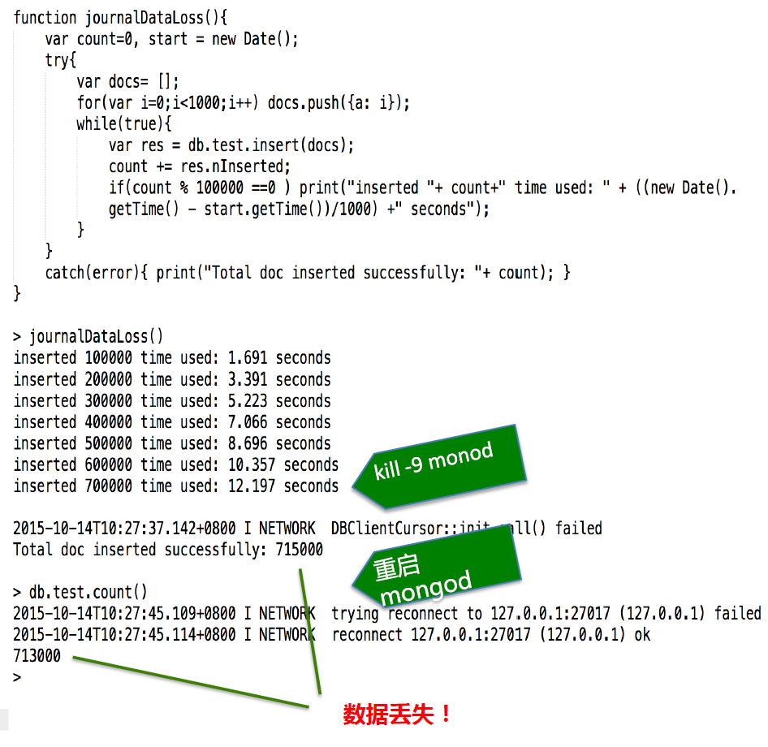

Slide 48
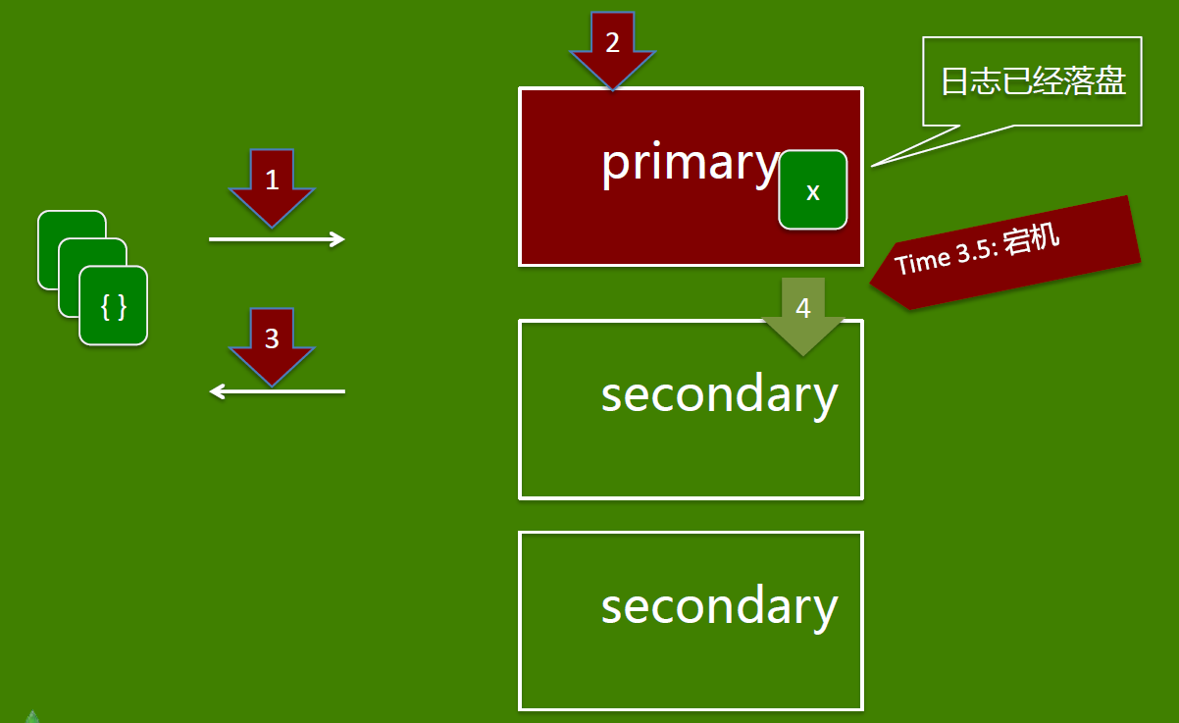

Slide 49
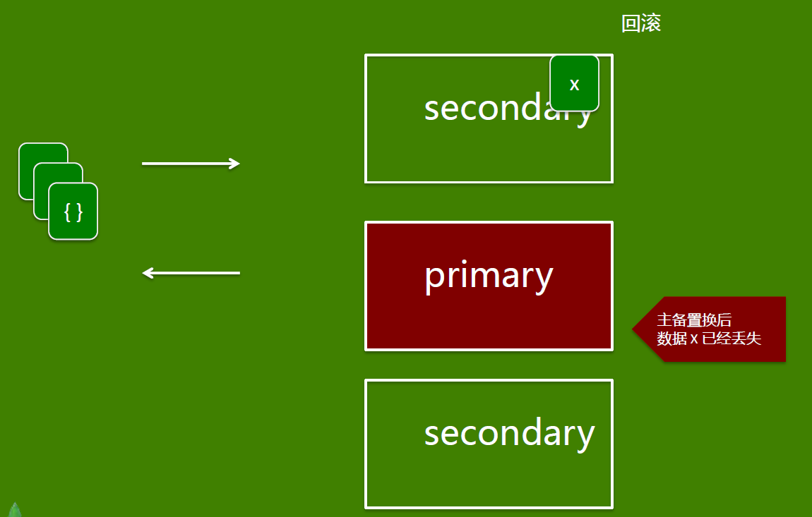

Slide 50
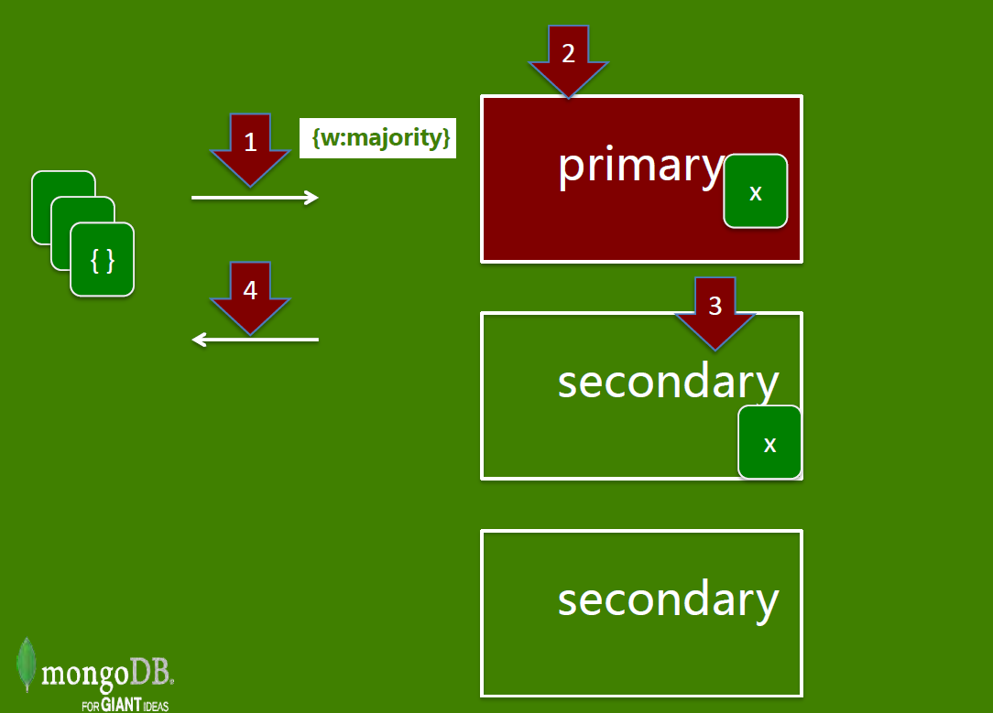

Slide 51
Scalability through Sharding

Slide 52
Needing to Scale-out?
Increasing volume of persisted data is too large for host machine?
Write throughput being constrained by hard disks of host machine?
Read latencies being constrained by the size of memory of host machine?

Slide 53
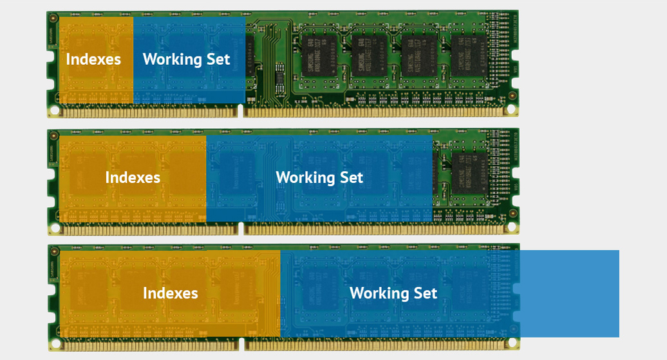
Working Set Exceeding RAM

Slide 54

Sharding
Auto-Sharding
Increase and decrease capacity as you go
Automatic Balancing
Transparent to applications
Scale capacity, scale reads, scale writes

Slide 55
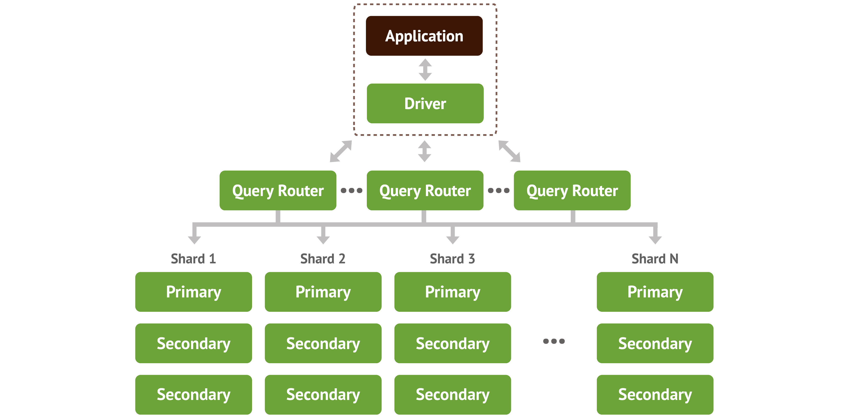
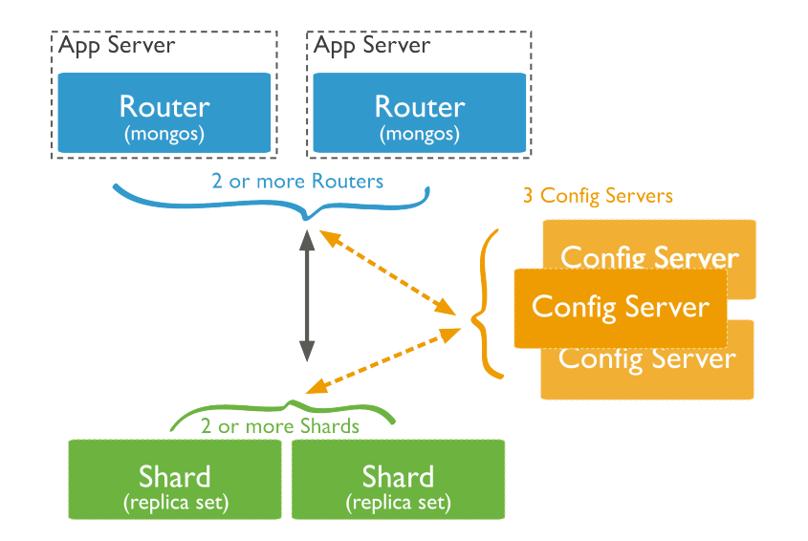

Slide 56
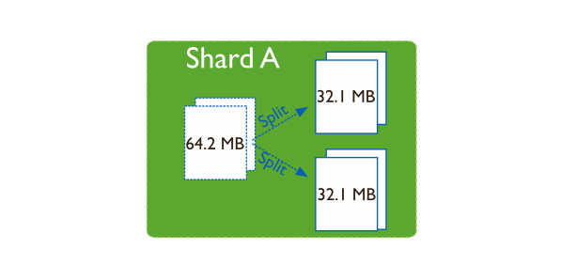
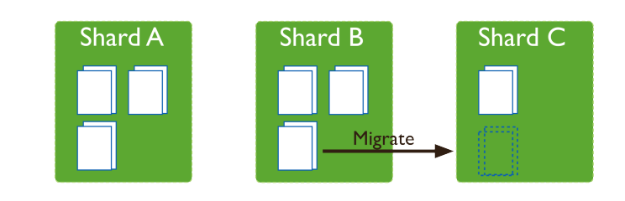
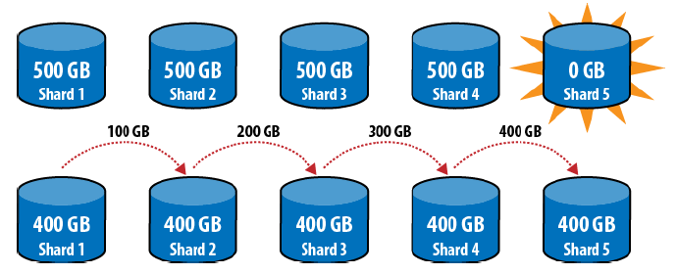
Spliting & Balancer

Slide 57
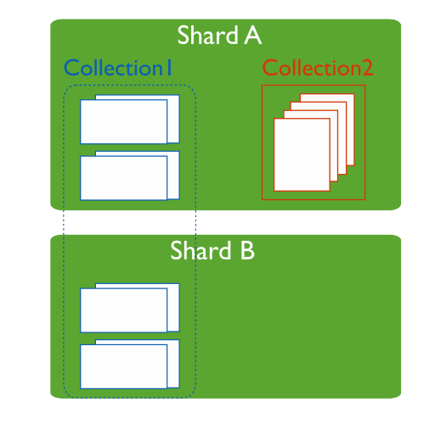
Primary Shard Every database has a “primary” shard that holds all the un-sharded collections in that database.

Slide 58
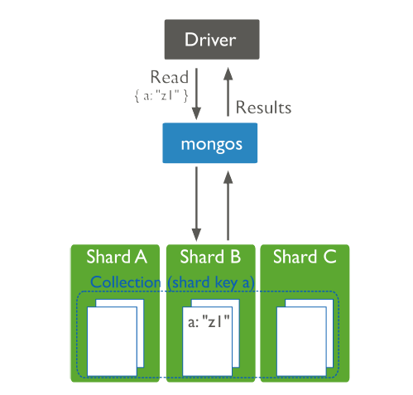
Shard Keys
The shard key determines the distribution of the collection’s documents among the cluster’s shards. The shard key is either an indexed field or an indexed compound field that exists in every document in the collection.

Slide 59
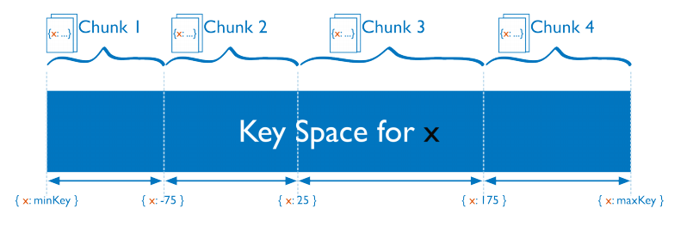
Range Based Sharding

Slide 60
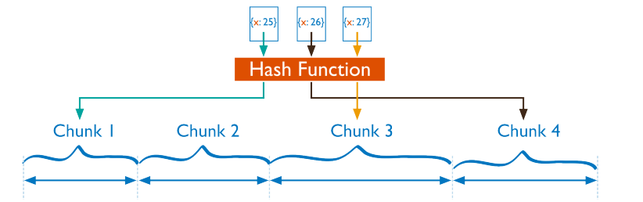
Hash Based Sharding

Slide 61
How do I pick a good Shard Key?
What do writes look like? What is the shape and size of the documents you’re
inserting?
• How much data is the system writing per hour? Per day? Peak?
• What fields are random, and which ones are increasing?
• What do reads look like? What data are people accessing?
• How much data is the system reading per hour? Per day? Peak?
• Is the data indexed? Should it be indexed?
• How much data is there, total?
• Write Distribution
• Query Isolation

Slide 62
Deployment Architectures

Slide 63
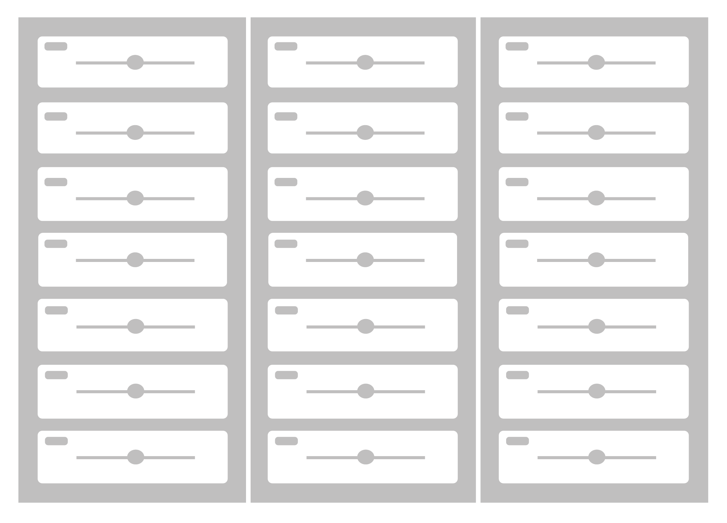
Single Data Centre
Primary – A
Primary – B
Primary – C
Automated failover
Tolerates server failures
Tolerates rack failures
Number of replicas defines failure tolerance
Secondary – B
Secondary – A
Secondary – A
Secondary – C
Secondary – C
Secondary – B

Slide 64
Active/Standby Data Centres
Primary – A
Primary – B
Primary – C
Secondary – B
Secondary – C
Secondary – A
Secondary – A
Secondary – B
Secondary – C
Data Center - West
Data Center - East
Tolerates server and rack failure
Standby data center for disaster recovery

Slide 65
Active/Active Data Centres
Primary – A
Primary – B
Primary – C
Secondary – A
Secondary – B
Secondary – C
Secondary – C
Secondary – A
Secondary – B
Secondary – B
Secondary – C
Secondary – A
Arbiter – A
Arbiter – B
Arbiter – C
Data Center - West
Data Center - Central
Data Center - East
Tolerates server, rack, data center failures, network partitions

Slide 66
Global Data Distribution
Real-Time
Real-Time
Secondary
Secondary
Real-Time
Secondary
Real-Time
Primary
Secondary
Real-Time
Secondary
Real-Time
Secondary
Real-Time
Secondary

Slide 67
Write locally, Read globally
Primary:LON
Secondary:NYC
Primary:NYC
Secondary:SYD
Secondary:LON
Secondary:SYD
Primary:SYD
Secondary:LON
Secondary:NYC

Slide 68
End

